Slide 1
Highland Oaks Elementary 5252 Annandale Memphis, TN 38125
Marchera James, Principal
Shaleah Carson, Assistant Principal
Annual Title I Parent Meeting
September 28, 2022 (5:00 – 6:00)
September 29, 2022 (10:00 – 11:00)
Tarneka Lofties, PLC Coach

Slide 2
What is Title I?
Title I is a program that is funded by the Federal Government that provides extra assistance to help students meet national and state achievement standards.
Notes:
Title I is the largest federal assistance program for our nation’s schools.
The goal of Title I is a higher quality of education for every child.
The program serves millions of children in elementary and secondary schools each year

Slide 3
Goals of Title I
Increase academic achievement
Provide direct instructional support to students
Provide professional development for teachers
Promote parent education and involvement
Notes:
Extra help (in addition to what the students learn during math and reading time in the classroom)
Is funded under No Child Left Behind
What is NCLB : is an education act (signed into law in 2002) that aims to assist schools in :
Raising accountability
Providing more financial flexibility to increase student acheivement
Setting goals
Improve teacher quality
Provide school choice
Make schools safer

Slide 4
ESSA
The “ Every Student Succeeds Act” (ESSA) of 2015 requires that each Title I School hold an Annual Meeting of Title I for parents for the purpose of...
• Informing you of your school’s participation in Title I
• Explaining the requirements of Title I
• Explaining your rights as parents to be involved
Notes:
The “ Every Student Succeeds Act” (ESSA) of 2015 requires that each Title I School holds an Annual Meeting of for parents for the purpose of...
• Informing you of your school’s participation in Title I
• Explaining the requirements of Title I
• Explaining your rights as parents to be involved
Cordova Middle Optional School is a Title I school.

Slide 6
ESSA
PURPOSE:
PROPOSITO:
“…To ensure that all children have a fair, equal, and significant opportunity to obtain a high-quality education…”
“…Para asegurar que todos los niños reciban una oportunidad justa, igual y significativo para obtener una educación de alta calidad…”

Slide 7
McKinney Vento Act
McKinney-Vento is a federal law that ensures the right of students to go to school even when they are displaced or don’t have a permanent address.
Specifically, McKinney-Vento provides guidelines public schools receiving federal dollars must follow to ensure students experiencing homelessness are provided access to Free Appropriate Public Education (FAPE).

Slide 8
Highland Oaks Elementary ESSA Title I/ AYP Status
Highland Oaks Elementary School IS a Title I School.
TN Ready scores fell into one of four new achievement levels, which were created through public feedback: exceeding expectations (level 4), met expectations (level 3), approaching expectations (level 2), and below expectations(level 1). These performance levels replaced the old terminology: mastered (level 4), on track (level 3), approaching (level 2), and below (level 1).

Slide 9
How Does HES Measure Up…

Slide 10
2021-2022 TN Ready Data
Subject | 2022 AMO
Reading | 34.7
Mathematics | 26.1
Highland Oaks Elementary is a
Level 5 School!

Slide 11
State and District Assessments
TN Ready is a part of the Tennessee Comprehensive Assessment Program (TCAP) and is designed to assess true student understanding, not just basic memorization and test-taking skills. It is a way to assess what our students know and what we can do to help them succeed in the future.
Mastery Connect Assessments (will be administered 3 times a year).
I-Ready Diagnostic (will be administered 3 times a year).
This Photo by Unknown Author is licensed under CC BY-SA

Slide 13
Title I, Part A: Basic Program Título I, Parte A: Programa Básico
Title I Schoolwide Programs
Provide resources to improve achievement as specified in the school’s ePlan.
Programas en todas las escuelas de Título I.
Proveer recursos para mejorar los logros académicos como está especificado en los Planes de Mejoramiento Escolar.

Slide 14
Components of a Title I Schoolwide Program Componentes de un Programa Escolar de Título I
Needs assessment
Schoolwide reform strategies that:
Increase the amount & quality of learning time (extended year, before- and after-school)
Address needs of all, but particularly low-achieving
Instruction by “highly qualified” teachers
Professional development
Necesita evaluación
Estrategias de reforma escolar que:
Aumentan el tiempo y calidad del tiempo de aprendizaje (año escolar extendido, programas antes y después de la escuela)
Dirigirse a las necesidades de todos, per especialmente a los que tienen un nivel bajo.
Instrucción por maestros “altamente calificados”
Desarrollo Profesional

Slide 15
Components of Title I Schoolwide Program (cont.) Componentes de un Programas Escolar de Título I (cont.)
Strategies to attract high quality teachers
Parental involvement
Transition from pre-school
Include teachers in assessment decisions
Timely, effective additional assistance
Coordination and integration of Federal, State, and local programs
Estategias para atraer a maestros altamente calificados.
Involucramiento de los Padres.
Transición de pre-escolar
Incluir a maestros en decisiones de evalucaión
Ayuda adicional efectiva y a tiempo
Coordinación e integración de los programas Federales, Estateles, y locales

Slide 16
Parents Right to Know El Derecho de Padres en Saber
Of the right to transfer if child is a victim of a violent crime
If child enters a Language Instruction Education Program (Title III)
Of the right to request child’s info not be released to military recruiter without prior consent
Eligibility for service if Migrant (Title I Part C)
Eligibility for Service if Homeless (Title X Part C)
Del derecho a la transferencia si el niño es víctima de un crimen violento
Si el estudiante entra a un Programa de Instrucción de Lenguaje. (Título III)
Por el derecho de solicitar información del niño no se liberará a reclutadores militares sin el consentimiento previo
Elegibilidad para el servicio en migrantes (Título I Parte C)
Elegibilidad para el servicio si no tiene hogar (Título X, parte C)

Slide 17
Parents Right to Know (cont.) El Derecho de Padres en Saber
Notify parents:
Of right to request data on qualification of teachers
If a child is taught by a teacher not highly qualified
If a child is provided instruction by a paraprofessional
If a teacher is hired for more than 4 weeks and is not highly qualified
If a school is identified as unsafe
Notifica a los padres:
Derecho de pedir infomación sobre los credenciales de los maestros
Si el estudiante recibe instrucción de un maestro no calificado
Si el estudiante recibe instrucción de un paraprofessional
Si el estudiante recibe instrucción de un maestro no calificado de cuatro semana
Si una escuela es identificada como inseguro

Slide 18
Parent Communication/ Reporting Student Progress
Interim Progress (District progress reports- 4th week of each 9-week period)
Report Cards
Phone calls/Notes
Parent Link
Wednesday Folders
Parent-Teacher Conferences
District Wide: September 8th
February 16th (4 – 7 pm)
Reportes de Progreso (La cuarto semana de cada periodo)
Llamadas telefónicas
Parent Link
Libros de agenda
Conferencias de Padres-Maestros
-En todo el distrito: September 8th 4pm-7pm
February 16th (4 – 7 pm)

Slide 19
Family Engagement /Parental Involvement Contrato con la Familia Involucramiento de Padres
District Policy/School Policy (Policy # 6156 provided)
Annual Meetings (September 28, 2022 & one in the Spring)
School-Parent Compacts
Building Capacity
Accessibility
Política Distrital/Politica Escolar (Política # 6156 provista)
Reuniones Anuales (28 de septiembre de 2022 & Una en la primavera)
Pactos de Padres/Escuela
Incrementando la capacidad
Accesibilidad

Slide 20
Representatives Needed! (1 to 2 parents per grade level)
Participate in Parent Assembly Meetings
Parental Involvement Committee
Participar en Asambleas para Padres.
Comité de Involucramiento de Padres

Slide 21
Suggested Parental Involvement Activities Actividades Sugeridas para el Involucramiento de Padres
Parental Involvement Informational Sessions/Professional Development
PTA
Parent Meetings
Sesiones Informativas de Participación de Padres / Desarrollo Profesional
PTA
Reunions de padres

Slide 22
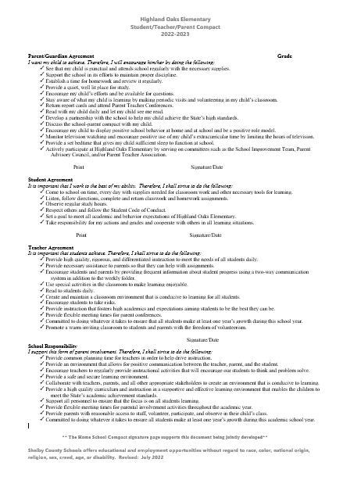
Highland Oaks Elementary School Parent Compact
The HES Compact is an agreement between parents, students, teachers, and the school which outlines ways to be actively involved in your child’s education.

Slide 23
Parent Responsibilities
Parent/Guardian Agreement
I want my child to achieve. Therefore, I will encourage him/her by doing the following:
See that my child is punctual and attends school regularly with the necessary supplies.
Support the school in its efforts to maintain proper discipline.
Establish a time for homework and review it regularly.
Provide a quiet, well-lit place for study.
Encourage my child’s efforts and be available for questions.
Stay aware of what my child is learning by making periodic visits and volunteering in my child’s classroom.
Return report cards and attend Parent Teacher Conferences.
Read with my child daily and let my child see me read.
Develop a partnership with the school to help my child achieve the State’s high standards.
Discuss the school-parent compact with my child.
Encourage my child to display positive school behavior at home and at school and be a positive role model.
Monitor television watching and encourage positive use of my child’s extracurricular time by limiting the hours of television.
Provide a set bedtime that gives my child sufficient sleep to function at school.
Actively participate at Highland Oaks Elementary by serving on committees such as the School Improvement Team, Parent Advisory Council, and/or Parent Teacher Association.

Slide 24
Student’s Responsibilities
It is important that I work to the best of my ability. Therefore, I shall strive to do the following:
Come to school on time, every day with supplies needed for classroom work and other necessary tools for learning.
Listen, follow directions, complete and return classwork and homework assignments.
Observe regular study hours.
Respect others and follow the Student Code of Conduct.
Set a goal to meet all academic and behavior expectations of Highland Oaks Elementary.
Take responsibility for my actions and grades and cooperate with others in all learning situations.

Slide 25
Teacher’s Responsibilities
It is important that students achieve. Therefore, I shall strive to do the following:
Provide high quality, rigorous, and differentiated instruction to meet the needs of all students daily.
Provide necessary assistance to parents so that they can help with assignments.
Encourage students and parents by providing frequent information about student progress using a two-way communication system in addition to the weekly folder.
Use special activities in the classroom to make learning enjoyable.
Read to students daily.
Create and maintain a classroom environment that is conducive to learning for all students.
Encourage students to take risks.
Provide instruction that fosters high academics and expectations aiming students to be the best they can be.
Provide flexible meeting times for parent conferences.
Committed to doing whatever it takes to ensure that all students make at least one year’s growth during this school year.
Promote a warm inviting classroom to students and parents with the freedom of volunteerism.

Slide 26
School’s Responsibilities
I support this form of parent involvement. Therefore, I shall strive to do the following:
Provide common planning time for teachers in order to help drive instruction.
Provide an environment that allows for positive communication between the teacher, parent, and the student.
Encourage teachers to regularly provide instructional activities that will encourage our students to think and problem solve.
Provide a safe and secure learning environment.
Collaborate with teachers, parents, and all other appropriate stakeholders to create an environment that is conducive to learning.
Provide a high- quality curriculum and instruction in a supportive and effective learning environment that enables the children to meet the State’s academic achievement standards.
Support all personnel to ensure that the focus is on all students learning.
Provide flexible meeting times for parental involvement activities throughout the academic year.
Provide parents with reasonable access to staff, volunteer, participate, and observe in their child’s class.
Committed to doing whatever it takes to ensure all students make at least one year’s growth during this academic school year.

Slide 27
School Improvement Plan
Highland Oaks will focus on improving the following areas:
Increasing Early Literacy in Grades K-2 through building foundational skills
Increase Reading Growth and Achievement for Grades 3-5
Increase Math Growth and Achievement for Grades 2-5
Decrease Disciplinary Infractions for all grades
Increase the School’s Attendance Rate

Slide 28
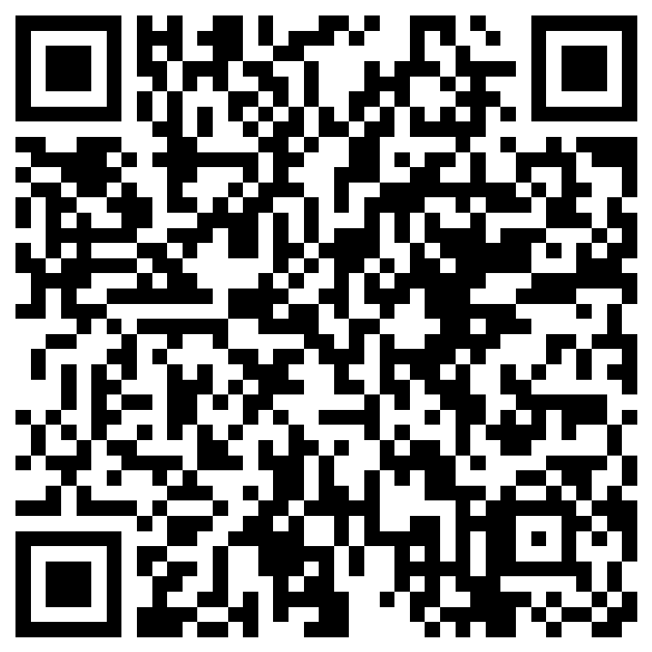
Title I
Parent and Family Engagement Survey

